Slide 1


Skew-Symmetric Error Distribution Analysis of Elasticity Dynamics of Firm Financial Statement Components: A Case Study in Indonesian Stock Markets using The Cobb-Douglas Linearized Log Form
Abstract
This study investigates the elasticity of total assets and number of employees on total revenue using a Cobb-Douglas production framework on Indonesian public firms. It compares classical OLS regression with a skew-symmetric regression model using the BFGS optimization algorithm. Findings show the skew-symmetric model outperforms classical models in terms of predictive power, residual normality, and information criteria (AIC/BIC), providing more accurate estimations in contexts with asymmetric data.
By:
Alexander Benedick
2501970115
School of Accounting - Accounting
Galvin Adriel Darvell Nadapdap
2501974334
School of Accounting - Accounting
Sasya Sabrina, S.E., M.M., CPSAK.
D5406
School of Accounting - Accounting
Skew-Symmetric Error Distribution Analysis of Elasticity Dynamics of Firm Financial Statement Components: A Case Study in Indonesian Stock Markets using The Cobb-Douglas Linearized Log Form

Slide 2

Introduction
Economics and Statistical Modelling
Modelling Economic Phenomenon
Statistical modeling has become central to financial statement analysis, with a shift toward advanced econometrics (e.g., time series, regression) for understanding firm behavior and valuation (Brooks, Damodaran)[1][2].
Techniques like the Cobb-Douglas Production Function are used to model firm output (Total Revenue) via capital (Total Assets) and labor (Total Employees), typically log-transformed to estimate elasticities in a regression framework, with residuals following a normal distribution process.
Traditional regression models assume normality with logarithmic quantity emphasis, but real-world financial data often exhibit skewness, especially in volatile emerging markets like Indonesia.[3]
Skew-Symmetric Distributions (Azzalini; Arellano & Bover) allow for better modeling of asymmetric residuals and improve estimation robustness under non-normal data conditions.[4]. Prior studies like Jiminchi et.al also confirms this [5]
The linear regression’s normality assumption
The skew symmetric distribution’s role
References:
Brooks, C. (2014). Introductory econometrics for finance (4th ed.). Cambridge University Press. (p. xxix).
Damodaran, A. (2012). Investment valuation: Tools and techniques for determining the value of any asset. John Wiley & Sons. (p. 36).
Bank Indonesia. (2021). Financial stability review: Safeguarding economic recovery amid financial sector resilience. Bank Indonesia.
Azzalini, A. (1985). A class of distributions which includes the normal ones. Scandinavian Journal of Statistics.
Jimichi, M., Kawasaki, Y., Miyamoto, D., Saka, C., & Nagata, S. (2023). Statistical Modelling of Financial Data with Skew-Symmetric Error Distributions. Symmetry, 15(9), 1772.
This study applies both classical and skew-symmetric Cobb-Douglas models to Indonesian firms, testing which better captures productivity through statistical diagnostics and normality/fit tests.
Skew-Symmetric Error Distribution Analysis of Elasticity Dynamics of Firm Financial Statement Components: A Case Study in Indonesian Stock Markets using The Cobb-Douglas Linearized Log Form

Slide 3
2. Literature Review
Theories Used:
Theory of Production (Cobb & Douglas);
Theory of the Firm (Coase); and
Classical regression limitations addressed using Azzalini’s skew-normal distribution.
Framework and Hypothesis:
H1 : Variables of Total Assets and Total Employees correlate significantly to a firm’s Total Revenue.
H2: A regression model incorporating skew-symmetric distributions provides a better estimation of firm performance compared to traditional symmetric regression models.
Theory of Production
Theory of The Firm
The firm combines and reconciliates the inputs of labor and capital into production.
Labor and capital have their tradeoffs between one and another in respective elasticities, by which one can utilize or prefer one or the other [1].
In financial statement analysis, the Cobb-Douglas function serves as a framework to assess how efficiently a firm allocates resources.
Empirical studies have validated this function in corporate finance, showing that asset utilization and workforce management significantly impact firm revenue such as the study of Hall and Jones [2]
According to Coase, firms exist to minimize transactions costs and operate efficiently in response to market forces and aim to maximize profits subject to competitive pressures [3].
In financial statement analysis, this theory underpins key financial ratios, such as return on assets (ROA), return on equity (ROE), and revenue efficiency metrics, to evaluate firm performance [4].
References:
Cobb, C. W., & Douglas, P. H. (1928). A theory of production. American Economic Review, 18(1), 139-165.
Hall, R. E., & Jones, C. I. (1999). Why do some countries produce so much more output per worker than others? Quarterly Journal of Economics, 114(1), 83-116.
Coase, R. H. (1937). The nature of the firm. Economica, 4(16), 386-405.
The nature of the firm. Economica, 4(16), 386-405.
Skew-Symmetric Error Distribution Analysis of Elasticity Dynamics of Firm Financial Statement Components: A Case Study in Indonesian Stock Markets using The Cobb-Douglas Linearized Log Form

Slide 4
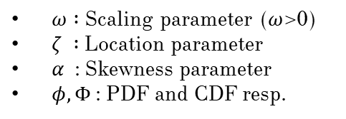

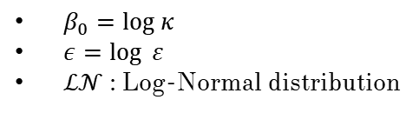
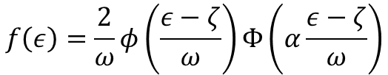

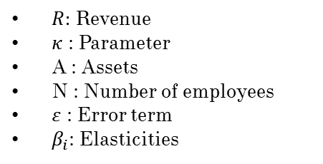





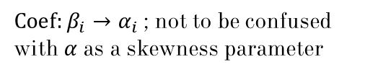

3. Methodology and Statistical formulation
The Outline of Equations
The Fundamental Formula
The Classical Regression
The Skew-Symmetric model
The Skew-Symmetric regression
4.
1.
2.
$$\log{R}=β_{0}+β_{1}\log{A}+β_{2}\log{N}+ε$$
3.
$$f\left(ε\right)=\frac{2}{ω}φ\left(\frac{ε−ζ}{ω}\right)Φ\left(α\frac{ε−ζ}{ω}\right)$$
$$\log{R}=α_{0}+α_{1}\log{A}+α_{2}\log{N}+ε$$
$$R=κA^{β_{1}}N^{β_{2}}ε$$
$$ε \sim f(ε|ζ, ω,α)$$
$$ε \sim ℒ𝒩(0,1)$$
Fundamental formula is built upon the model proposed by Charles Cobb and Paul Douglas, in which Output is the result.
The formula regressed is a log form Cobb -Douglas, by which it is the base model taken its logs. The residuals follow a Classical Regression process of Log-Normal Distributions
We optimize the parameters of the Classical Regression so that the residual instead of following a Log-Normal Distribution, follows a Skew-Symmetric Distribution. Optimization is via BFGS Algorithm
We regressed a new model with new parameters α (alpha) where the coefficients are adjusted to the residuals of the Skew-Symmetric distribution
$R:$ Revenue
$κ$ : Parameter
A : Assets
N : Number of employees
$ε$ : Error term
$β_{i}$: Elasticities
$β_{0}=log κ$
$ε=\log{ ε }$
$ℒ𝒩$ : Log-Normal distribution
$ω :$ Scaling parameter ($ω$>0)
$ζ :$ Location parameter
$α$ : Skewness parameter
$φ, Φ$ : PDF and CDF resp.
$Coef:β_{i}→α_{i}$; not to be confused with $α$ as a skewness parameter
Properties of Cobb-Douglas
Diminishing Marginal Property
Returns to scale
Marginal Rate of Technical Substitution (MRTS)
Marginal Product of Capital :${ R}_{A}=β_{1}\frac{A}{R}>0 ;R_{AA}=−β_{1}\frac{A}{R^{2}}$
2.
Constant : $β_{1}+β_{2}=1⇒R\left(kx\right)=kR(x)$
3.
1.
Increasing :$β_{1}+β_{2}>1⇒R\left(kx\right)>kR(x)$
$$MRTS=\frac{R_{A}}{R_{N}}=\frac{β_{1}}{β_{2}}\frac{A}{N}$$
Marginal Product of Labor :${ R}_{N}=β_{2}\frac{N}{R}>0 ;R_{NN}=−β_{2}\frac{N}{R^{2}}$
Decreasing : $β_{1}+β_{2}<1⇒R\left(kx\right)<kR(x)$
$$∗∀x=(A,N)$$
Methods
Type: Quantitative secondary data using yfinance (YahooFinance)
Sample: 90 sample of IDX-listed firms (Q3 2023–Q3 2025)
Regression Models:
Classical OLS (log-linear)
Skew-symmetric with BFGS optimization
Tests:
Shapiro-Wilk (normality)
Breusch-Pagan (heteroscedasticity)
Durbin-Watson (autocorrelation)
AIC/BIC (model quality)
Skew-Symmetric Error Distribution Analysis of Elasticity Dynamics of Firm Financial Statement Components: A Case Study in Indonesian Stock Markets using The Cobb-Douglas Linearized Log Form

Slide 5
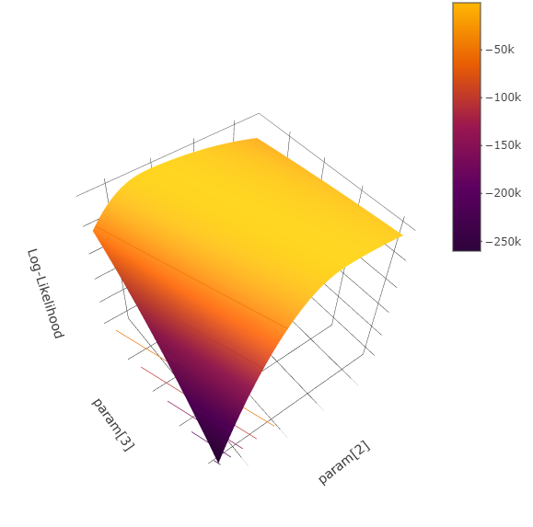


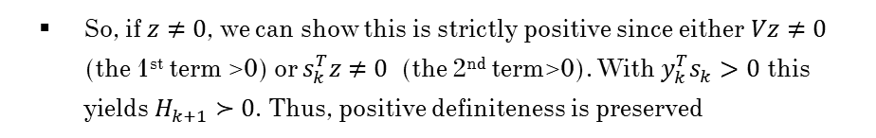



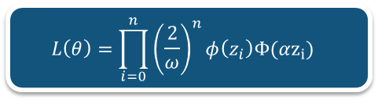

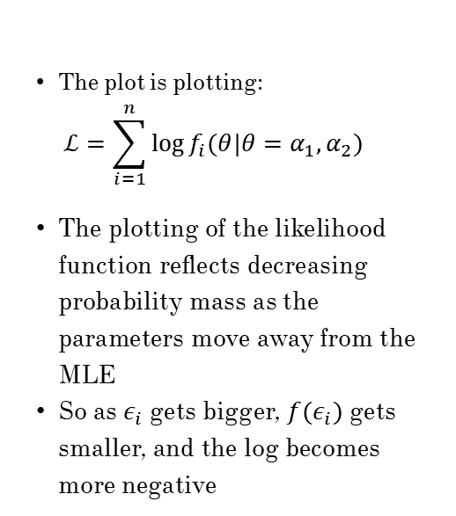









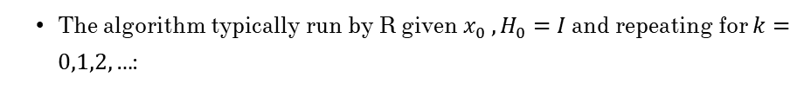
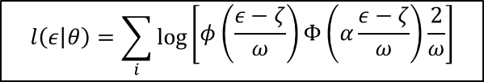


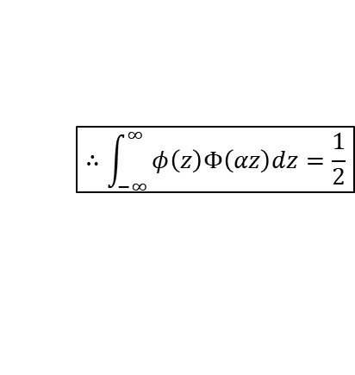


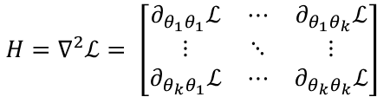


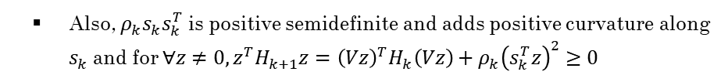


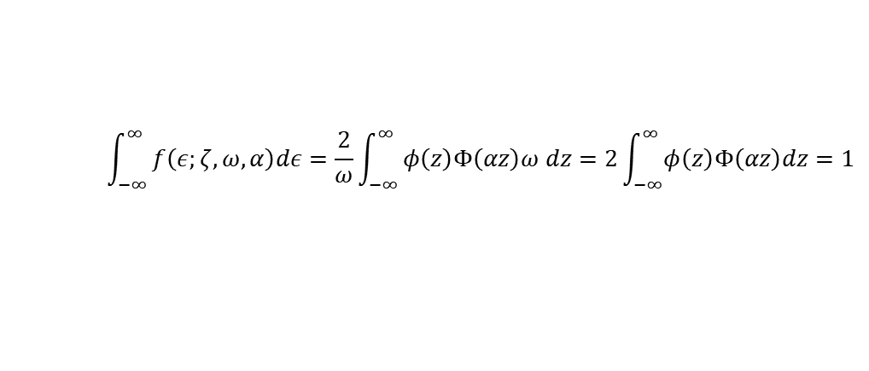

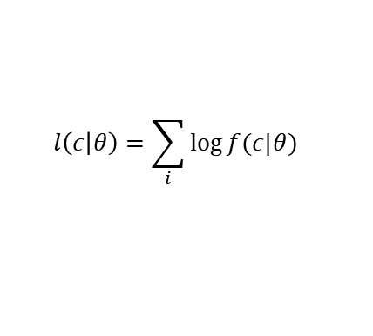
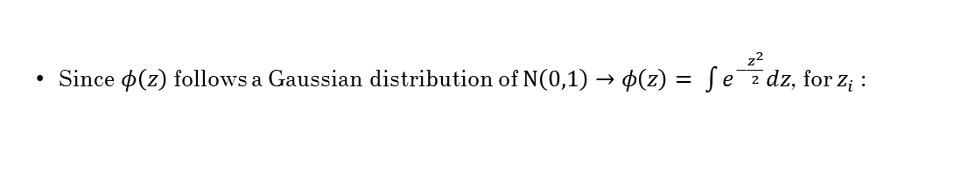

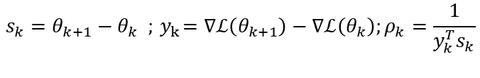

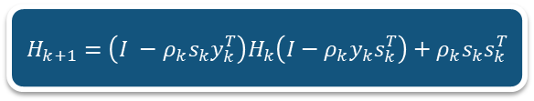

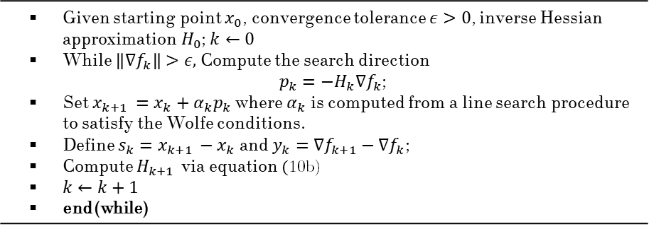
3. Methodology and Statistical formulation
The Skew-Symmetric Distribution
The Hessian
The BFGS Algorithm
1.
$$L\left(θ\right)=\prod_{i=0}^{n}{{\left(\frac{2}{ω}\right)}^{n}φ\left(z_{i}\right)Φ(αz_{i}) }$$
2.
$$H_{k+1}=\left(I −ρ_{k}s_{k}y_{k}^{T}\right)H_{k}\left(I−ρ_{k}y_{k}s_{k}^{T}\right)+ρ_{k}s_{k}s_{k}^{T}$$
3.
$$\left\|∇f_{k}\right\|>ε⇒p_{k}=−H_{k}∇f_{k}$$
The regression of the log-linear function is analogues as standard linear regression
The Hessian matrix is:
The implementations used is:
$y_{i}=a+bx_{i}+ε_{i}$
$$\text{(1)}$$
$$H=∇^{2}ℒ= \left[\begin{matrix}∂_{θ_{1}θ_{1}}ℒ & ⋯ & ∂_{θ_{1}θ_{k}}ℒ \\ ⋮ & ⋱ & ⋮ \\ ∂_{θ_{k}θ_{1}}ℒ & ⋯ & ∂_{θ_{k}θ_{k}}ℒ\end{matrix}\right]$$
$H_{k+1}= H_{k}−$ $\frac{H_{k}s_{k}^{T}s_{k}H_{k}}{s_{k}^{T}H_{k}s_{k}}+\frac{y_{k}y_{k}^{T}}{y_{k}^{T}s_{k}}$
The log-likelihood of the function is formulated in the form :
$$\text{(7)}$$
$$\text{(10}\text{a}\text{)}$$
$$l\left(ε | θ\right)=\sum_{i}{\log{f(ε|θ)}}$$
$$\text{(2)}$$
An example can be demonstrated as:
The implementations used is the inverse Hessian:
$$\frac{∂^{2}ℒ}{∂α^{2}}=−\sum_{i}{\frac{1}{Φ{\left(αz_{i}\right)}^{2}}[φ{\left(αz_{i}\right)}^{2}−αz_{i}φ\left(αz_{i}\right)Φ\left(αz_{i}\right)]}$$
$H_{k+1 }=H_{k}−\left(I−\frac{s_{k}y_{k}^{T}}{y_{k}^{T}s_{k}}\right)H_{k}\left(I−\frac{y_{k}s_{k}^{T}}{y_{k}^{T}s_{k}}\right)+\frac{s_{k}s_{K}^{T}}{y_{k}^{T}s_{k}}$
$$\text{(10}\text{b}\text{)}$$
Now we insert the $x_{i}$ as $ε$ and $θ=\left(ζ, ω, α\right)$and also $Φ ,φ$ as the CDF and PDF respectively, thus the skew symmetric likelihood is:
The algorithm typically run by R given $x_{0} , H_{0}=I$ and repeating for $k=0,1,2,…$:
$$l\left(ε | θ\right)=\sum_{i}{\log{\begin{aligned}\left[φ\left(\frac{ε−ζ}{ω}\right)Φ\left(α\frac{ε−ζ}{ω}\right)\frac{2}{ω}\right] \\ \end{aligned}}}$$
Since this is too tedious to compute by hand. The numerical algorithm of the BFGS comes to the rescue. The BFGS is formulated commonly by the following iteration:
$$\text{(3)}$$
Given starting point $x_{0}$, convergence tolerance $ε>0$, inverse Hessian approximation $H_{0}$; $k←0$ While $\left\|∇f_{k}\right\|>ε,$Compute the search direction $p_{k}=−H_{k}∇f_{k}$; Set $x_{k+1 }=x_{k}+α_{k}p_{k}$ where $α_{k}$ is computed from a line search procedure to satisfy the Wolfe conditions. Define $s_{k}=x_{k+1 }−x_{k}$ and $y_{k}=∇f_{k+1}−∇f_{k}$; Compute $H_{k+1 }$ via equation$\text{(}\text{10}\text{b}\text{)}\text{)}$ $k←k+1$ end(while)
Or:
Start with initial guess and Hessian estimate $θ_{0}$ and $H_{0}=I$ respectively where I is the identity matrix. At the $k^{th}$ iteration:
$$l\left(ε | θ\right)=\sum_{i}{\log\left(2\right)−\log\left(ω\right)+\log{\begin{aligned}\left[φ\left(\frac{ε−ζ}{ω}\right)\right]+\log{\begin{aligned}\left[Φ\left(α\frac{ε−ζ}{ω}\right)\right] \\ \end{aligned}} \\ \end{aligned}}}$$
T$he normalization factor of z=(ε−ζ)/ω$ :
$$θ_{k+1}=θ_{k}−H^{−1}∇ℒ(θ_{k})$$
$$\text{(8)}$$
$$\int_{−∞}^{∞}{f\left(ε;ζ,ω,α\right)dε=\frac{2}{ω}\int_{−∞}^{∞}{φ\left(z\right)Φ\left(αz\right)ω dz=2\int_{−∞}^{∞}{φ\left(z\right)Φ\left(αz\right)dz=1} }}$$
$$\text{(4)}$$
Update via:
$$s_{k}=θ_{k+1}−θ_{k} ;{ y}_{k}=∇ℒ\left(θ_{k+1}\right)−∇ℒ\left(θ_{k}\right);ρ_{k}=\frac{1}{y_{k}^{T}s_{k}}$$
$$\text{(9}\text{a}\text{)}$$
$$∴\int_{−∞}^{∞}{φ\left(z\right)Φ\left(αz\right)dz=\frac{1}{2}}$$
*see: Nocedal & Wright(2000), Numerical Optimization, Ch. 6; p.139-141
Since $φ\left(z\right)$ follows a Gaussian distribution of $N\left(0,1\right)→φ\left(z\right)= \int{e^{−\frac{z^{2}}{2}}dz}$, for $z_{i}$ :
$$H_{k+1}=\left(I −ρ_{k}s_{k}y_{k}^{T}\right)H_{k}\left(I−ρ_{k}y_{k}s_{k}^{T}\right)+ρ_{k}s_{k}s_{k}^{T}$$
$$\text{(9}\text{b}\text{)}$$
Log-Likelihood Plot
The matrix is positive definite. To show this:
The plot is plotting:
$$ℒ=\sum_{i=1}^{n}{\log{f_{i}(θ|θ=α_{1},α_{2})}}$$
The plotting of the likelihood function reflects decreasing probability mass as the parameters move away from the MLE
So as $ε_{i}$ gets bigger, $f(ε_{i})$ gets smaller, and the log becomes more negative
$$z_{i}=\frac{ε_{i}−ζ}{ω}=\frac{y_{i}−a−bx_{i} −ζ}{ω}$$
$$\text{(5)}$$
We let :
$$V=I −ρ_{k}s_{k}y_{k}^{T}$$
The final log-likelihood becomes :
So, equation (9b) is :
$$H_{k+1}=VH_{k}V^{T}+ρ_{k}s_{k}s_{k}^{T}$$
$$ℒ\left(θ\right)=−n log\left(ω\right)−\frac{n}{2}log\left(2π\right)−\frac{1}{2}\sum_{i=1}^{n}{z_{i}^{2}}+\sum_{i=1}^{n}{log Φ\left(αz_{i}\right)}+nlog\left(2\right)$$
Basically, $VH_{k}V^{T}$ is symmetric positive semi-definite because${ H}_{k}≻0$
$$\text{(6}\text{a}\text{)}$$
Also, $ρ_{k}s_{k}s_{k}^{T}$ is positive semidefinite and adds positive curvature along $s_{k}$ and for $∀z≠0, z^{T}H_{k+1}z={\left(Vz\right)}^{T}H_{k}\left(Vz\right)+ρ_{k}{\left(s_{k}^{T}z\right)}^{2}≥0$
Or in exponential form
$$L\left(θ\right)=\prod_{i=0}^{n}{{\left(\frac{2}{ω}\right)}^{n}φ\left(z_{i}\right)Φ(αz_{i}) }$$
$$\text{(6}\text{b}\text{)}$$
So, if $z≠0$, we can show this is strictly positive since either $Vz≠0$ (the 1st term >0) or $s_{k}^{T}z≠0$ (the 2nd term>0). With $y_{k}^{T}s_{k}>0$ this yields $H_{k+1}≻0$. Thus, positive definiteness is preserved
Skew-Symmetric Error Distribution Analysis of Elasticity Dynamics of Firm Financial Statement Components: A Case Study in Indonesian Stock Markets using The Cobb-Douglas Linearized Log Form

Slide 6
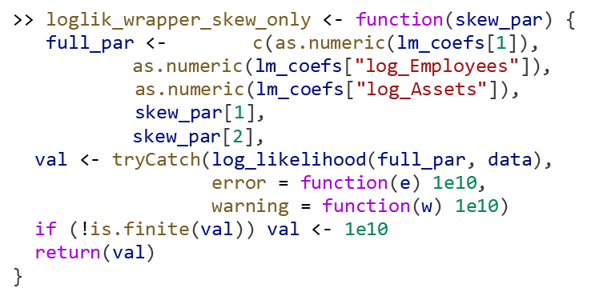




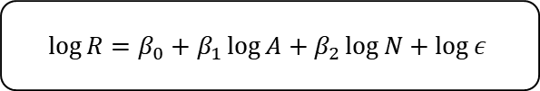

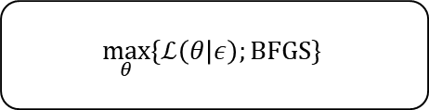

3. Methodology and Statistical formulation
Simplified Outline of Code in R-Language
Define the function
*Libraries used:
5.
$$f_{0}(z_{0}, ω_{0},α_{0})$$
Define the initial skew
readxl
tidyverse
lmtest
sandwich
sn
optimx
car
ggplot2
plotly
psych
knitr
MASS
gridExtra
– Importing Excel-based financial data
6.
$$θ_{0}=(z_{0}, ω_{0},α_{0})$$
– Data manipulation and transformation
– Regression diagnostics (e.g. BP,DW tests)
Define the log likelihood
– Robust variance–covariance estimation
init_skew <- c(z0, ifelse(is.na(omega0) || omega0 <= 0, 1, omega0), alpha0)
– The Skew-Normal Distribution function
1.
$ℒ(θ|ε)$ ; $θ=\left(α_{0}, α_{1}, α_{2},ζ, ω, α\right)$
– The optimization for BFGS
– Regression utilities and diagonstics
– Data visualization (later for diagnostics plot)
>>log_likelihood <- function(params, data) {
alpha0 <- params[1]
alpha1 <- params[2]
alpha2 <- params[3]
zeta <- params[4]
omega <- abs(params[5])
alpha <- params[6]
>> ll <- sum(dsn(residuals, xi = zeta, omega = omega, alpha = alpha, log = TRUE))
>> return(-ll) }
– The 3D plot of Cobb-Douglas
– Descriptive stats
– For readable output
Optimizing the skew-symmetric
– The pseudo-inverse for Heissan matrix
$$\max_{θ_{0}}{\{f(θ_{0});BFGS\}}$$
– Multipanel figure
7.
Parameters for the skew statistics
>> opt_skew <- optim(
par = init_skew,
fn = loglik_wrapper_skew_only,
method = "BFGS",
hessian = TRUE,
control = list(maxit = 2000, reltol = 1e-8)
)
$$ε :Residual;$$
$z_{0}:Median$;
$ω_{0}:Std Dev$;
$$α_{0}=0$$
4.
*in the code, the regression is inside the log-likelihood function
>> resid_fe <- residuals(lm_fe)
>> z0 <- median(resid_fe, na.rm = TRUE)
>> omega0 <- sd(resid_fe, na.rm = TRUE)
>> alpha0 <- 0
Define optimization
2.
$$\max_{θ}{\{ℒ\left(θ | ε\right);BFGS\}}$$
Redefining the Regression and Output
Define the Regression
$$\log{R}=α_{0}+α_{1}\log{A}+α_{2}\log{N}+\log{ε}$$
result <- optim(
par = init_params,
fn = log_likelihood,
data = data,
method = "BFGS"
)
$$\log{R}=β_{0}+β_{1}\log{A}+β_{2}\log{N}+\log{ε}$$
8.
model_refined <- list(
lm = lm_fe,
coef_table = summary(lm_fe)$coefficients,
skew_table = skew_table,
skew_logLik = -opt_skew$value,
residuals = residuals(lm_fe)
call = match.call()
)
class(model_refined) <- "model_refined"
3.
>> predicted_log_sales <- alpha0 + alpha1 * data$log_Employees + alpha2 * data$log_Assets
>> lm_fe <- lm(log_Revenue ~ log_Assets + log_Employees, data = data)
Skew-Symmetric Error Distribution Analysis of Elasticity Dynamics of Firm Financial Statement Components: A Case Study in Indonesian Stock Markets using The Cobb-Douglas Linearized Log Form

Slide 7
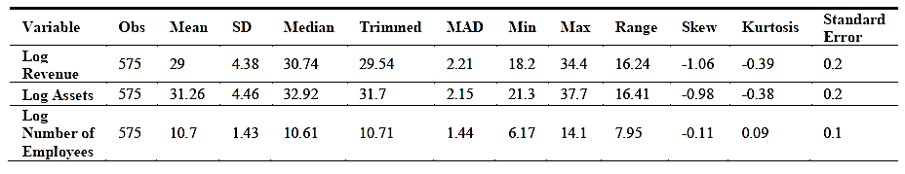
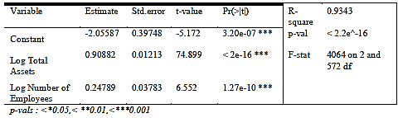
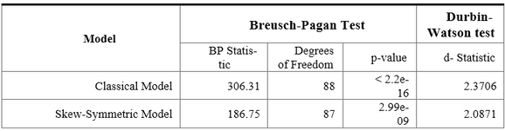

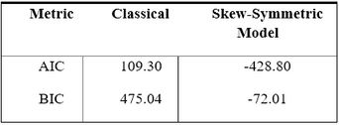
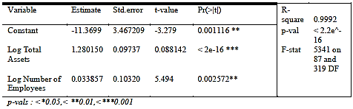

4. Results - Stats
Descriptive Statistics
Descriptive Statistics shows Skewness:
Based on the summary of descriptive statistics, the data shows a heavily skewed data for the Revenue and Total Assets of each firm
Regression
Model Testing and Comparison
Classical Regression Results
Classical Regression predicts with good accuracy:
Autocorrelation and Heteroskedasticity Test
Skew-Symmetric has low BP Test and smaller DW Test
Shows strong significance in both log-assets and log-employees. R-squared = 0.9343 means 93.43% of revenue variation is explained.
Caution: Although fit is high, this model ignores skewed residuals, risking bias.
The Breusch-Pagan test indicates heteroskedasticity in both models, but the Skew-Symmetric model has a much lower BP statistic (186.75 vs. 306.31). The Durbin-Watson statistic for both models is close to 2, indicating no autocorrelation.
Optimization results for the Skew-Symmetric model
Optimized via BFGS Algorithm:
Information Criterion Tests
Information Criterion shows far small variabilities of deviation in the Skew-Symmetric models:
Parameters α0,α1,α2, represent the regression coefficients.
ζ,ω,α are the skew-normal distribution parameters (location, scale, skewness).
AIC and BIC are used to compare model quality. Lower values mean better performance. Skew-Symmetric model has much lower values (AIC = −428.80, BIC = −72.01), clearly outperforming the Classical model.
The Regression results for the Skew-Symmetric model
Skew-Symmetric Regression also predicts with good accuracy:
The Normality Tests shows the Skew Regression to be more Normal:
Shapiro-Wilk Test for Normal Data
The Skew-Symmetric Regression results also show all variables are statistically significant. R-squared = 0.9993 indicates near-perfect model fit
The Shapiro-Wilk W-statistic for the Skew model (0.98251) is much closer to 1, indicating residuals are closer to a normal distribution. Classical model residuals deviate strongly from normality (W = 0.77591).
Skew-Symmetric Error Distribution Analysis of Elasticity Dynamics of Firm Financial Statement Components: A Case Study in Indonesian Stock Markets using The Cobb-Douglas Linearized Log Form

Slide 8
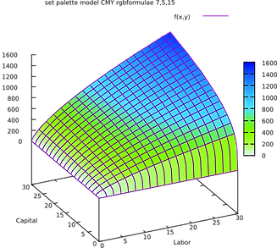
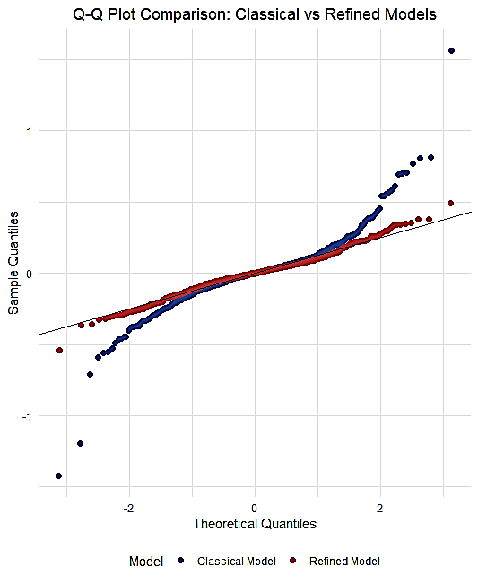
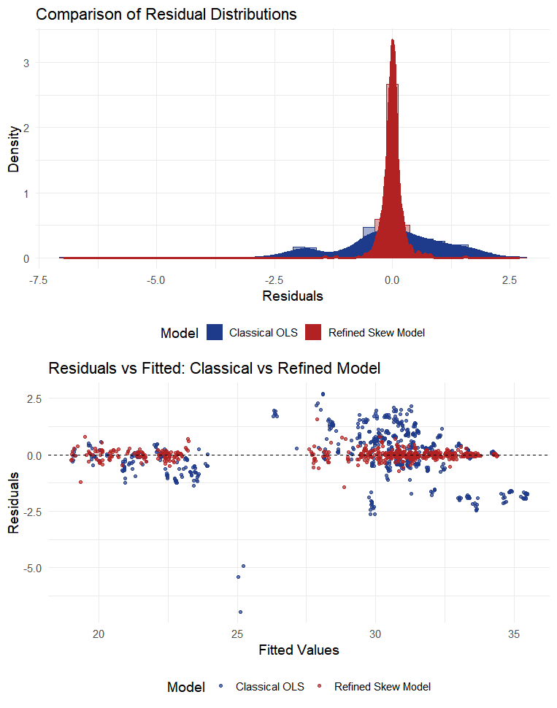
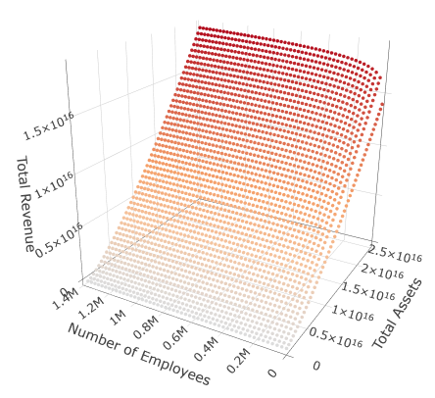
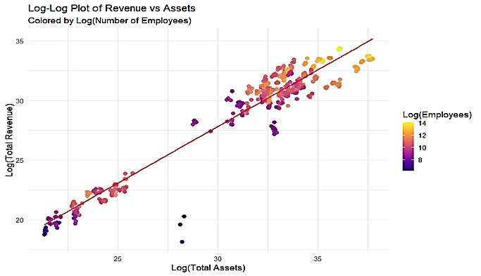
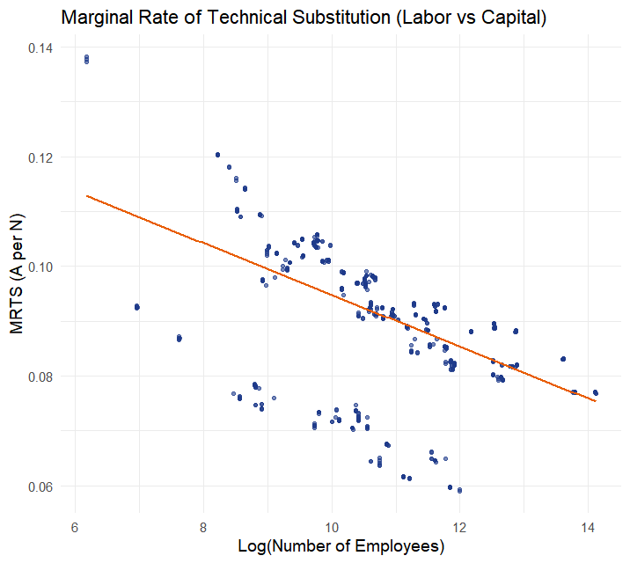
4. Results - Graphs
The Cobb-Douglas Plot
QQ-Plot
Residuals comparison
Using the Coefficients as elasticity in form
Typical Cobb Douglas
The empirical plot follows the Cobb-Douglas Production Function Log-Linear and Logarithmic exponential form
Source : https://www.econowiki.com/_media/en/cobb-douglas-1.svg.png
The model when plotted in R’s Q-Q plot shows that the theoretical quantiles are almost linear for the Skew-Symmetric
Under a skew-normal likelihood, the refined model centers the residuals and reduces dispersion, in which confirming that the skew-symmetric assumption better represents the underlying data-generating process
Linear Plot
MRTS
The plot shows a very linear good to fit alignment of Total Revenue with Total Assets whilst assuming the Number of Employees is Constant
The skew-normal specification produces centered and homoscedastic residuals, indicating improved distributional symmetry and model fit relative to the OLS benchmark
The MRTS scatter plot confirms that as firms become larger in terms of labor, each additional worker substitutes less capital
Skew-Symmetric Error Distribution Analysis of Elasticity Dynamics of Firm Financial Statement Components: A Case Study in Indonesian Stock Markets using The Cobb-Douglas Linearized Log Form

Slide 9
4. Discussion and Limitations
Disccusion and Interpertation
Limitations
Prior Research Alignment
Structural Market Differences
1.
Limited Time Span
Findings align with Jimichi et al.’s application of the Cobb–Douglas and skew-symmetric model in the Japanese market. [1]
Confirms the model’s reliability in capturing elasticity and asymmetry in firm-level financial data.
Japan: high capital intensity, aging demographics, and strong capital-labor substitution. [2]
Indonesia: shift from manufacturing to resource-based sectors increases aggregate capital intensity and heterogeneity. [3]
Dataset sourced from Yahoo Finance for simplicity.
Limited time span (1–2 years) of quarterly data reduces robustness compared to multi-year studies.
1.
Further Suggestions
2.
2.
Conservative Modelling
Extend dataset across more years and firms
Referencing the previous graph…
Intentional simplicity: regression with few core variables for clear log-likelihood optimization.
Ensures interpretability but trades off robustness of richer variable inclusion.
1.
Indonesia’s revenue surface driven by asset growth.
Suggests a capital-intensive economy, where mining and resource firms dominate revenue generation patterns.
Incorporate comprehensive financial statement variables
3.
Comparison with Prior studies
2.
Jimichi’s model included industry dummy variables and multiple explanatory factors.
Our conservative model omits variables like profit ratios and sectoral adjustments, reducing generalization power.
Comparison with our Method
Explore non-conservative formulations
Alternative econometric methods include:
SFA (Stochastic Frontier Analysis) for productivity/efficiency.
GMM & Panel Cointegration Tests (PCT) for macro-financial linkages.
Present study’s Cobb–Douglas + Skew-Symmetric model preserves interpretability and captures fat-tailed residuals typical in emerging markets.
3.
Jimichi, M., Kawasaki, Y., Miyamoto, D., Saka, C., & Nagata, S. (2023). Statistical Modelling of Financial Data with Skew-SymmetricError Distributions. Symmetry, 15(9), 1772.
International Monetary Fund. (2010). Japan’s quest for growth:Exploring the role of capital and innovation (Working Paper No. 10/294). IMF.
Rudolf, J. (2025, August 21). Why a commodities boom is not lifting Indonesia’s economy. Financial Times.
3.
Skew-Symmetric Error Distribution Analysis of Elasticity Dynamics of Firm Financial Statement Components: A Case Study in Indonesian Stock Markets using The Cobb-Douglas Linearized Log Form

Slide 10
5. Conclusion
Regression significance
Supports previous theory
Total assets and number of employees significantly influence revenue (supports Cobb-Douglas & firm theory)
Supports Cobb-Douglas & firm theory
Skew-Symmetric usability
Supports Hypothesis
Skew-symmetric regression yields better model performance than classical OLS
Supports the Hypothesis of H₁ and H₂ earlier formulated
Recommendations
Recommends wider use of skew-aware models in accounting and financial econometrics
Skew-Symmetric Error Distribution Analysis of Elasticity Dynamics of Firm Financial Statement Components: A Case Study in Indonesian Stock Markets using The Cobb-Douglas Linearized Log Form

Slide 11
5. Conclusion
Thank you
Skew-Symmetric Error Distribution Analysis of Elasticity Dynamics of Firm Financial Statement Components: A Case Study in Indonesian Stock Markets using The Cobb-Douglas Linearized Log Form

